Slide 1


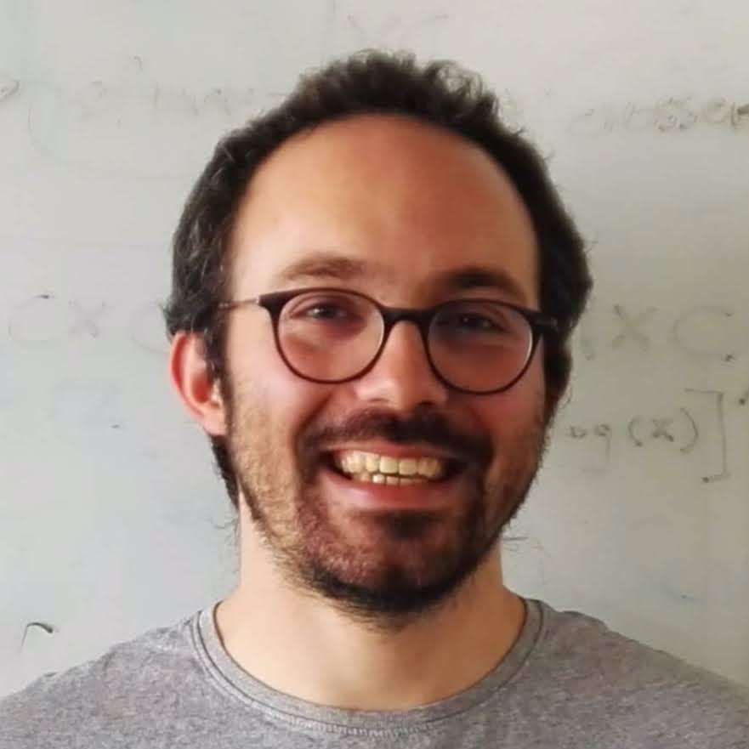



Achieving Microsecond-Scale Tail Latency Efficiently with Approximate Optimal Scheduling
Rishabh Iyer
Musa Unal
Marios Kogias
George Candea
Notes:
Today I will tell you about Concord: a system that enables datacenter applications to meet their microsecond-scale tail latency objectives while sustaining high throughput. This is joint work with my collaborators Musa and Marios and my advisor George Candea.

Slide 2


Tail Latency Matters for Datacenter Applications
R
R
R
R
R
Tail latency SLOs are expected to become tighter with time
Notes:
Datacenter applications today are expected to meet stringent microsecond-scale tail-latency service level objectives or SLOs at individual servers.
This is because every user request is fanned out across hundreds of servers with the end-to-end response time determined by the server with the slowest response.
And these strict tail-latency SLOs are only expected to get tighter with time as applications are modularized into increasingly finer microservices and communication stacks are offloaded to specialized hardware.

Slide 3
Low Tail Latency: A Question of Scheduling
Tail latency dominated by queueing delay (not service time)
State-of-the-art schedulers optimized based on queuing theory
Theoretical answers are clear¹
Single-queue scheduling [ZygOS SOSP’17, Shenango NSDI’19]
Preemptive scheduling [Shinjuku NSDI’19]
¹Wierman and Zwart: Is Tail-Optimal Scheduling Possible? In Journal of Operating Research (2012)
Notes:
Since the tail latency of a request at individual servers is dominated by its queueing delay (and not the service time), state-of-the-art schedulers are optimized based on queueing theory.
Now from a theoretical point of view, the results are very clear: In a nutshell, they state that that in order to minimize tail latency across different service time distributions, schedulers must support two policies
(a) a single request queue to avoid load imbalance across cores, and
(b) preemptive scheduling to ensure that short requests do not suffer from head of line blocking due to long running ones.

Slide 4


Optimal Scheduling Sacrifices Throughput!
Systems answers are less clear
Canonically implementing optimal policies mandates high-overhead mechanisms
Notes:
However, from a systems point of view the answer is less clear. And this is because improving tail latency by canonically implementing these policies necessitates the use of mechanisms with high overhead.
This sacrifices the maximum throughput that such systems can sustain, with the sacrificed throughput only increasing as service times grow shorter.
The figure on this slide provides an abstract visualization of the sacrificed throughput. Implementing theoretically optimal policies makes systems move from the blue to the orange curve;. This has the benefit of keeping tail latency low for up to a greater load but the downside is that using these expensive mechanisms results in them saturating sooner than their non-tail-optimized counterparts.

Slide 5
Optimal Scheduling Sacrifices Throughput!
Systems answers are less clear
Canonically implementing optimal policies mandates high-overhead mechanisms
Can we improve maximum sustainable throughput without sacrificing tail latency?
Notes:
[Question] So the question we ask is, Is it feasible to improve maximum sustainable throughput without sacrificing tail latency?
That is, go from the orange curve to the green curve.

Slide 6
Insight: Approximate Optimal Policies
Enables low-overhead µs-scale scheduling mechanisms
Significant throughput improvements at negligible tail latency cost
Low-overhead mechanisms improve throughput
Approximating optimal policies retains shape of the curve
Notes:
In the rest of the talk I will demonstrate that it is indeed feasible and that the key to doing so is to carefully approximate (as opposed to canonically implement) theoretically-optimal policies.
This is because approximating optimal policies enables low-overhead, microsecond-scale scheduling mechanisms that significantly improve application throughput.
Going back to our comparative illustration, this enables us to achieve the best of both worlds because by closely approximating optimal policies, we retain the shape of the orange curve and the low-overhead mechanisms that approximation enables ensure that the curve shifts to the right.

Slide 7
Concord: A µs-Scale Scheduling Runtime
18-52% increased throughput at today’s timescales; 45-83% at future timescales
2X lower overhead than latest HW support for scheduling
52% increase
LevelDB workload with 50% GETs, 50% SCANs
Notes:
We use this insight to build Concord, a scheduling runtime for microsecond-scale datacenter mechanisms. Concord introduces low-overhead mechanisms to approximate both a single queue and precise preemption.
One thing I want to emphasize here is that Concord’s mechanisms do not rely on non-standard use of hardware or application-level assumptions, so it can be immediately deployed in the public cloud for a wide variety of applications.
In fact, as I will show you in a little while, Concord’s mechanisms outperform even the latest hardware support for scheduling.
The graph below provides a glimpse of Concord’s throughput improvements over two state of the art schedulers.
I will come back to this graph later, but what I want you to take away is that Concord’s results mirrors the abstract visualization from the previous slide.

Slide 8
Concord: A µs-Scale Scheduling Runtime
18-52% increased throughput at today’s timescales; 45-83% at future timescales
2X lower overhead than latest HW support for scheduling
Approximating optimal scheduling significantly improves throughput at µs-scale at a negligible tail latency cost
52% increase
LevelDB workload with 50% GETs, 50% SCANs
Notes:
So if there is one thing I want you to take away from this talk, it is that approximating (as opposed to canonically implementing) theoretically optimal scheduling policies significantly increases throughput at microsecond scale at negligible tail latency costs.

Slide 9
Outline
Design
Approximating precise preemption
Approximating a single queue
Evaluation
Throughput benefits at today’s timescales
Are Concord’s mechanisms future proof?
Notes:
Here is the outline for the rest of my talk.
First, I will describe Concord’s design and how it approximates both a single queue and precise preemption.
Then I will present a few highlights from our evaluation and conclude.

Slide 10
Outline
Design
Approximating precise preemption
Approximating a single queue
Evaluation
Throughput benefits at today’s timescales
Are Concord’s mechanisms future proof?
Notes:
So let’s start with Concord’s design.

Slide 11
System Model
Worker
thread
R
N
I C
Dispatcher thread
Worker
thread
R
R
R
R
Global
single queue
.......
Worker
thread
Dispatcher and workers are pinned to CPU cores for maximum locality
R
Notes:
Now before I dive into the details, I want to first introduce an abstract system model that I will use throughout this part of the talk to illustrate both the throughput overheads of optimal policies and how approximating these policies mitigates the overhead.
The system model is the one you see on this slide. There is a single dispatcher thread and 𝑛 worker threads, all of which are pinned to individual CPU cores. The dedicated dispatcher maintains the single queue. This asymmetric threading model represents how many (albeit not all) state-of-the-art microsecond-scale systems are built, the paper describes how our ideas generalize to systems that use a symmetric threading model as well.
So given this model, let’s start by looking at preemptive scheduling

Slide 12

Overhead Due to Precise Preemption: Interrupts
Worker
core
R
N
I C
Dispatcher core
Worker
core
R
R
R
R
Global
single queue
.......
Worker
core
R
Notes:
The state-of-the-art w.r.t preemptive scheduling is to use inter-processor interrupts or IPIs for short. The dispatcher monitors how long each worker thread has been executing for and

Slide 13

Overhead Due to Precise Preemption: Interrupts
Worker
core
R
Inter-Processor Interrupt (IPI)
N
I C
Dispatcher core
Worker
core
R
R
R
R
Global
single queue
.......
Worker
core
Preemption is precise
Receiving IPIs is expensive (~1200 cycles)
R
Notes:
whenever it has reached the desired scheduling quantum, it sends the core in question an IPI.
The benefit of IPIs is that the preemption is precise; the worker promptly stops processing the current request and moves on to the next one.
The drawback is the large cost of receiving IPIs. For instance, receiving an IPI in Shinjuku costs ≈1200 cycles which results in an ≈12% overhead for a 5us quantum assuming a 2GHz clock. Note, Shinjuku’s IPIs rely on non-standard use of virtualization hardware and cannot be deployed in the public cloud. The corresponding overhead for traditional Linux’s IPIs is double. [PAUSE]
So clearly using interrupts to achieve precise preemption comes with prohibitive overheads. But does preemption have to be precise?

Slide 14
Does Preemption Need to Be Precise?
Queueing simulation: scheduling quantum modeled as Normal random variable
Small imprecisions in scheduling quantum have negligible impact on tail latency
Notes:
To answer this question, we ran a queuing simulation for multiple service time distributions where we modeled the scheduling quantum as a random variable with a normal distribution, as opposed to a constant value.
The figure here shows the results for a Bimodal workload with 99.5% of requests take 0.5µs, and 0.5% of requests take 500µs. We observed similar results for other workloads as well.
We see that as long as preemption occurs within a “small” interval around the desired quantum, the sustained throughput for a target SLO is not. significantly affected. Said differently, approximating the scheduling quantum does not significantly change the shape of the graph.

Slide 15
Compiler-Enforced Cooperation
Worker
core
R
N
I C
Dispatcher core
Worker
core
R
R
R
R
Global
single queue
.......
Worker
core
R
Notes:
So we use this observation to make preemption asynchronous in Concord using a mechanism that we call Compiler-enforced cooperation.
This works as follows: On one hand (as before), the dispatcher monitors how long each request has been executing and

Slide 16
Compiler-Enforced Cooperation
Worker
core
R
Write to dedicated cache line
$
N
I C
Compiler-inserted probes
Dispatcher core
Worker
core
R
R
R
R
Global
single queue
$
.......
Worker
core
Concord automatically converts worker threads from “interrupt-driven CPU drivers” to “poll-mode CPU drivers”
R
$
Notes:
when the request has reached the end of its scheduling quantum it writes a value (say 1) to a shared cache line (instead of sending an interrupt). On the other hand, Concord uses compiler instrumentation to ensure that the application code periodically checks the value of this shared cache line and whenever it sees that it has been written to by the dispatcher, it yields the CPU.
So effectively, Concord AUTOMATICALLY converts worker threads from being “interrupt-driven CPU drivers” to “poll-mode CPU drivers” to reduce overheads just like how the majority of low-latency systems today eschew interrupts in favor of polling. [Pause]
Now, compiler-enforced cooperation approximates precise preemption since workers do not yield instantaneously: they must first reach the cache-line check to see the preemption notification. However, this design significantly reduces the overhead of preemption.

Slide 17
Compiler-Enforced Cooperation: Overhead
Minimize cost of preemption notification
Cache line is the fastest way for 2 cores to communicate
Low probe cost: Predictable branch + L1 cache hit
12x lower at 2µs
10x lower at 5µs
Notes:
This is because Concord minimizes the cost of the preemption notification itself since a shared cache line is the fastest way to communicate between two cores on shared memory multiprocessors
Further, the cost of the probes is very low because it consists of only a branch and a read. Since this branch is very rarely taken, we can bias the branch predictor and since the cache line is almost always in the L1 cache of the worker core, the read cost is negligible as well.
The graph below shows the overhead of Concord’s compiler-enforced cooperation in comparison to Shinjuku’s IPIs as a function of the scheduling quantum. We see that Concord’s overhead is significantly lower and is in fact 12× lower at a scheduling quantum of 2µs and 10× lower at a quantum of 5µs. We also include a naive form of compiler instrumentation as a baseline, here the code is instrumented with rdtsc() calls to allow it to know when the quantum has elapsed instead of relying on the dispatcher. However, frequently invoking rdtsc() leads to an overhead that is worse than that of IPIs since rdtsc() calls are expensive.

Slide 18
Outline
Design
Approximating precise preemption
Approximating a single queue
Evaluation
Throughput benefits at today’s timescales
Are Concord’s mechanisms future proof?
Notes:
So, so far I’ve told you how Concord approximates precise preemption using compiler instrumentation which basically automatically converts worker threads from being “interrupt-driven CPU drivers” to “poll-mode CPU drivers” to reduce overheads just like how the majority of low-latency systems today eschew interrupts in favor of polling.
I will now move on to how Concord approximates a single queue.

Slide 19
Overheads Due to Single Request Queue
Dedicated dispatcher does not contribute to goodput
Worker
core
R
$
Done
N
I C
New Req
Dispatcher core
Worker
core
R
R
R
R
Global
single queue
$
.......
Worker
core
Cache coherence stalls due to sync. communication
R
$
Notes:
In this system model, a single queue has two sources of throughput overhead.
First and foremost: the dispatcher core which does not contribute to application goodput. While burning one core does not significantly impact throughput when running on a large server, it does have a serious impact for smaller VMs in the cloud.
The second overhead is more nuanced and arises due to cache coherence stalls. These occur because a single queue requires that a new request only be sent over to a worker thread once it has finished processing its current request to ensure optimal load balancing. This puts two cache coherence misses on the critical path because the worker threads are forced to remain idle while the dispatcher thread first reads from and then writes to the request queue. These cache coherence misses have been ignored by prior work since their overhead is much lower than that of IPIs, but once the preemption notification itself is just one cache coherence miss, these can have a significant impact.
Let’s now take a look at how Concord mitigates these two overheads.

Slide 20
Work-Conserving Dispatcher
Concord leverages rdtsc()instrumentation for the dispatcher to ensure timely responses to workers, network
Worker
core
R
$
N
I C
Dispatcher core
Worker
core
R
R
R
R
Global
single queue
$
.......
R
Worker
core
Work-conservation approximates a single queue because requests cannot be migrated from/to the dispatcher
R
$
Notes:
To mitigate the first overhead, Concord uses a work-conserving dispatcher, i.e., whenever the dispatcher notices that the application threads are busy it contributes to application goodput by processing user requests for one quantum.
To ensure that the dispatcher retains the ability to respond to network and worker events in a timely manner, the dispatcher runs a version of the application code that is instrumented with rdtsc() probes. rdtsc() is necessary since there is no external entity available to preempt the dispatcher and so it must preempt itself.
Such a work-conserving dispatcher leads to an approximation of the single queue because requests that have been processed by a worker cannot be processed by the dispatcher and vice versa, since the instruction pointers are different due to the different instrumentation.
However, we show in the paper that this approximation does not significantly impact tail latency..

Slide 21
Join-Bounded-Shortest Queue (JBSQ)
Worker
core
R
$
N
I C
Dispatcher core
Worker
core
R
R
R
R
Global
single queue
$
.......
R
Worker
core
R
$
Notes:
To eliminate the overhead due to worker threads being idle, Concord carefully trades the optimal single queue policy in favor of the Join-Bounded-Shortest-Queue or JBSQ policy which approximates an ideal, work-conserving single queue by combining a single, central queue with

Slide 22
Join-Bounded-Shortest Queue (JBSQ)
Done
Queue depth of 2 hides stalls for realistic workloads
Worker
core
R
R
New Req
$
N
I C
Dispatcher core
Worker
core
R
R
R
R
R
Global
single queue
$
.......
R
R
R
Worker
core
Bounded per-worker queue
$
Notes:
short, bounded per-worker queues.
Using bounded per-worker queues enables the Concord dispatcher to push new requests asynchronously. This ensures that upon completing a request, worker threads can immediately begin processing a new request from their local queue, thus eliminating the idle time spent waiting for the next request.
A natural question at this point is what the depth of each worker queue should be, in order to not significantly impair load balancing (and hence tail latency). In practice we found that a queue depth of 2 is sufficient to eliminate worker thread stalls.

Slide 23
Outline
Design
Approximating precise preemption: Compiler-enforced cooperation
Approximating a single queue: Work-conserving dispatcher + JBSQ
Evaluation
Throughput benefits at today’s timescales
Are Concord’s mechanisms future proof?
Notes:
So, at this point, I have told you how Concord approximates precise preemption using compiler-enforced cooperation and approximates a single queue using a work-conserving dispatcher and JBSQ. I will now present a few higlights from our evaluation. As I mentioned previously, I will first show how Concord outperforms the state of the art at today’s timescales before showing how the performance improvements only grow as timescales become shorter. Finally, I will describe how Concord outperforms the latest HW support for scheduling.

Slide 24
Methodology
Focus: Blind scheduling policies
Baselines:
Shinjuku: Single queue + precise preemption
Persephone-FCFS: Single queue
Metric:
Sustained throughput for a given 99.9th percentile Slowdown
Set SLO at 50x slowdown; consistent with prior work

Slide 25
Distributions with High Variability
52%
LevelDB server workload with 50% GETs, 50% SCANs
GETs: 600ns, SCANs: 500µs
Scheduling quantum = 5µs

Slide 26
Distributions with Low Variability
2% less than FCFS
Synthetic workload based on TPCC running on an in-memory DB

Slide 27
Concord at Shorter Timescales
Scheduling quantum = 2µs
83%
LevelDB server workload with 50% GETs, 50% SCANs
GETs: 600ns, SCANs: 500µs

Slide 28
Concord vs User Interrupts
2X lower overhead
Shared cache line is the fastest way for two cores to communicate on shared mem. HW

Slide 29
More Results In The Paper!
Throughput improvements for several other service time distributions
Contribution of each mechanism to overall throughput improvements
Compiler overhead across 25 benchmarks from Phoenix, Parsec, Splash-2
2x lower overhead
Shared cache line is the fastest way for two cores to communicate on shared-memory HW

Slide 30

Concord: A µs-Scale Scheduling Runtime
Approximating optimal scheduling significantly improves throughput at microsecond-scale at a negligible tail latency cost
https://dslab.epfl.ch/research/concord

Slide 31
Backup Slides

Slide 32
Safety-First Preemption in Concord
Compiler has full control over code it instruments
Do no instrument external library/syscalls
Long running external calls rare in µs-scale applications
Must modify code to avoid preemption during critical sections in application
Only 4 LOC changed in LevelDB
Wrapper around mutex lock, unlock

Slide 33
Bimodal Distribution
18%
Synthetic workload with Bimodal distribution
50%: 1µs, 50%: 100µs
Scheduling quantum = 5µs

Slide 34
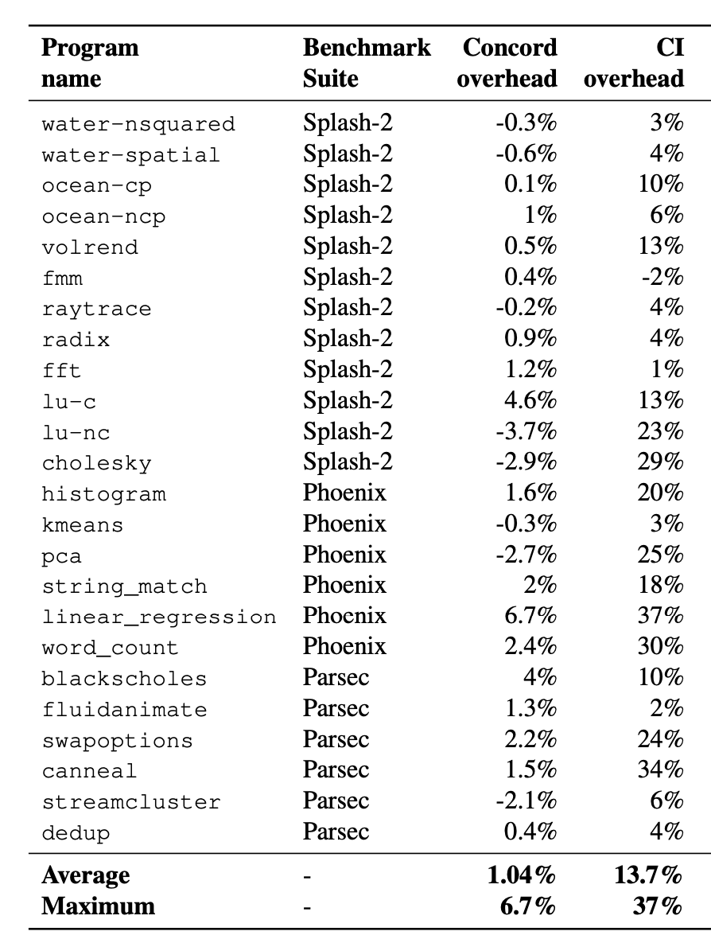
Compiler Overhead Across Programs

